Slide 1
Osher Lifelong Learning Institute, Fall 2026
Contemporary Economic Policy
University of Massachusetts, Boston
Host: Geoffrey Woglom, Director
National Economic Education Delegation

Slide 2
Course Schedule
Contemporary Economic Policy
  Week 1 (9/16): Economic Update & Changes at the Fed, Geoffrey Woglom, Amherst College
  Week 2 (9/23): Economic Inequality, Joseph Carolan, Oakland University
  Week 3 (9/30): Saving Social Security, Geoffrey Woglom, Amherst College
  Week 4 (10/07): Federal Debt, Dmitriy Stolyarov, University of Michigan
  Week 5 (10/14): Trade and Globalization, Andreas Waldkirch, Colby College
  Week 6 (10/21): Climate Change Economics, Sarah Jacobson, Williams College

Slide 3


Trade and Globalization
October 14, 2026
Andreas Waldkirch, Colby College
The Mitchell Family Professor of Economics

Slide 4
Submitting Questions
I encourage questions. We will do a verbal Q&A at the end.
During the talk, please put questions in the chat and I will try and pause occasionally and answer some during the talk
Slides will be available from the NEED website https://needecon.org/delivered_presentations.php.

Slide 5
Trade is natural and advantageous
Neanderthals:
Hunters traded fur for berries
Gatherers traded berries for fur

Slide 6
World Trade

Slide 7
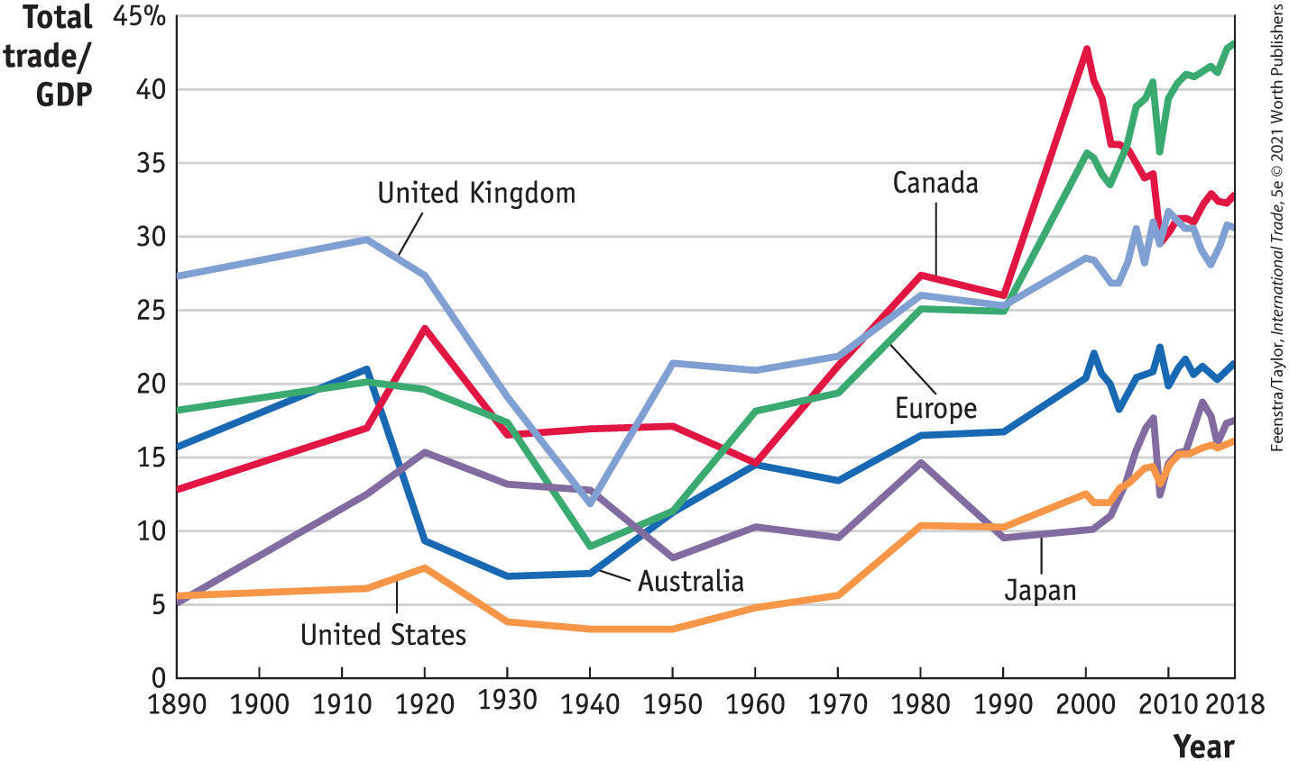
The Importance of Trade

Slide 8
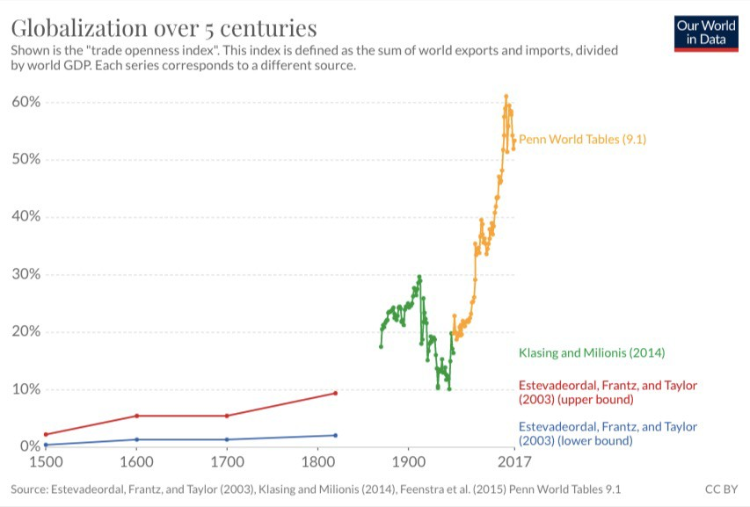

Slide 9
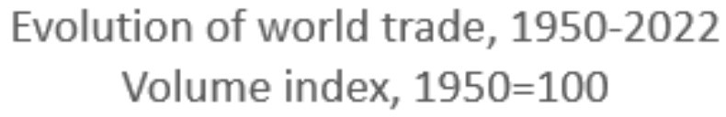
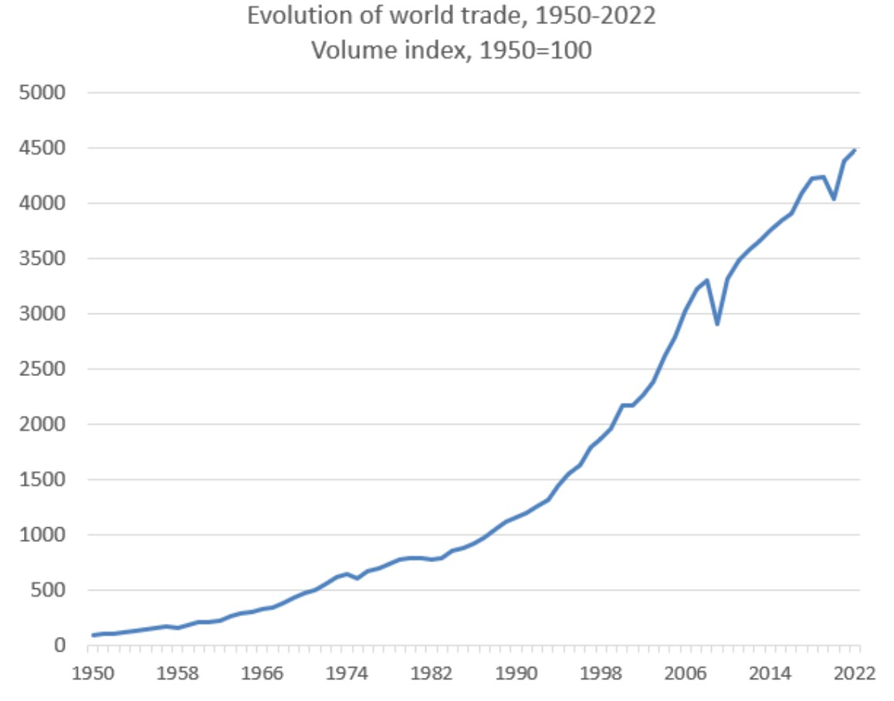
Evolution of World Trade 1950-2022, volume index, 1950=100
Evolution of World Trade, 1950-2022 Volume index, 1950=100
Source: WTO

Slide 10
World Merchandise Trade by Region, %

Slide 11
World Services Trade by Region, %

Slide 12
U.S. Trade

Slide 13
Partner Countries US Imports

Slide 14
U.S. Export and Import partners 2025
 | Exports | Imports | Balance | Trade Share (%) | Change from 2024
Total | 2063.8 | 3356.8 | -1293.0 | 100 | 0
Canada | 329.7 | 392.4 | -62.8 | 12.7 | -1.5
Mexico | 338.0 | 539.0 | -201.0 | 15.4 | -0.2
Brazil | 54.4 | 41.6 | 12.8 | 1.7 | 0
United Kingdom | 96.8 | 65.6 | 31.2 | 2.9 | +0.2
Germany | 82.7 | 159.0 | -76.3 | 4.3 | -0.1
France | 50.8 | 69.3 | -18.5 | 2.1 | +0.2
Italy | 43.7 | 76.4 | -32.7 | 2.1 | +0.1
Ireland | 19.3 | 133.9 | -114.6 | 2.7 | +0.5
China | 106.3 | 327.5 | -221.2 | 7.6 | -3.6
Japan | 82.0 | 149.8 | -67.8 | 4.1 | -0.2
Korea | 68.8 | 129.0 | -60.3 | 3.5 | -0.2
India | 45.6 | 107.6 | -62.0 | 2.7 | +0.2
Vietnam | 15.7 | 201.3 | -185.6 | 3.8 | +0.9
Saudi Arabia | 14.1 | 10.9 | 3.1 | 0.4 | -0.1
Australia | 33.7 | 28.9 | 4.8 | 1.1 | +0.2

Slide 15
A View from International Trade Theory & Policy
Trade is not a zero-sum game: the theory of Comparative Advantage
Trade creates Winners and Losers
The Winners should compensate the Losers
An orderly, rules-based trading system is to the benefit of all

Slide 16
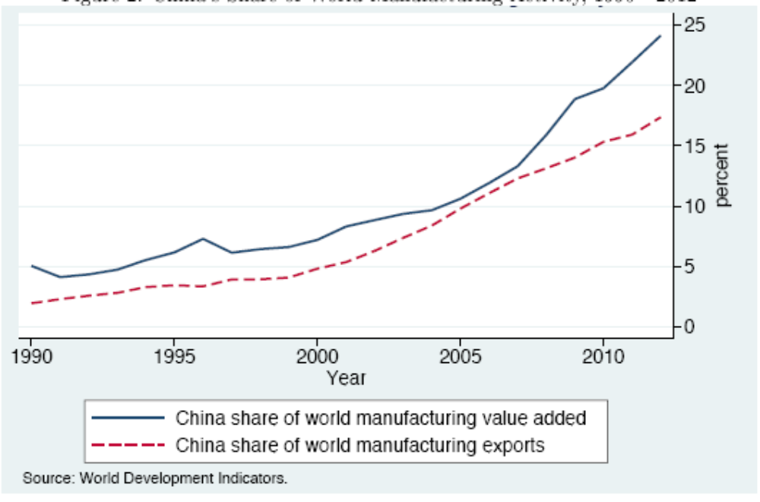
The China Shock

Slide 17
Trade Disrupts Job Markets
China Shock 1991-2011: ≈ 2 million jobs displaced in import-competing industries (Acemoglu, Autor, Dorn, Hanson, Price)
Impact on some communities were devastating.
  Concentrated job losses, home prices fell, cuts to local services, reduced marriage and fertility.
Research suggests that nationally, jobs expanded in other industries by about the same number, or possibly more.
  Cheaper imported inputs allow import-using sectors to grow faster.
  Feenstra, Ma and Xu; Wang, Wei, Yu, and Zhu

Slide 18
Let’s talk about tariffs
A tariff is a tax on imports.
A 10% tariff on all imports would mean that
  Whatever the foreign exporter charges for a product,
  US buyers will pay an extra 10% to the US government.

Slide 19
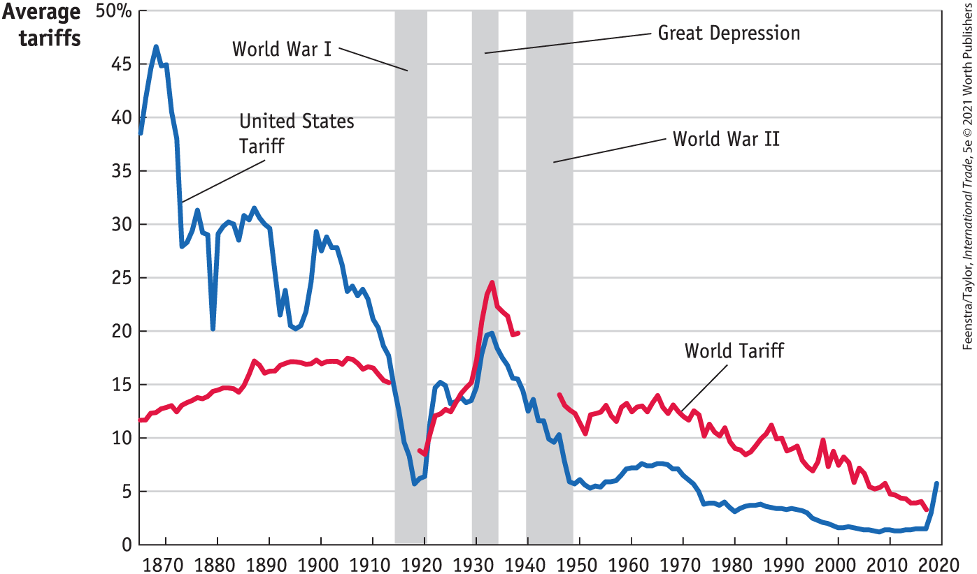
Tariff History: World and U.S.

Slide 20
The New World of Tariffs: Highlights
Limited tariffs 2018-19: solar panels, steel and aluminum, China
Very limited rollbacks 2021-2024, some new tariffs (e.g. EVs)
New tariffs on select goods Jan-March 2025, justified in US trade law
Blanket tariffs on ALL countries since April 2025, based on IEEPA
Feb 20, 2026: The Supreme Court strikes down blanket tariffs
Selected Tariffs, based on various provisions in U.S. trade law

Slide 21
Justification for Tariffs
Unfair trade practices, such as illegal subsidies or dumping
National security concerns
Address persistent trade deficits
Compel countries to agree to new trade deals

Slide 22
What about these Justifications?
Unfair trade practices: rooted in US trade law, based on Office of the US Trade Representative investigations
National security concerns: rooted in US trade law, based on Department of Commerce investigations,
but applied to Automobiles, pharmaceuticals, semiconductors, steel and aluminum, copper, lumber and products like kitchen cabinets and bathroom fixtures, foreign cargo vessels, rare earth minerals, ship-to-shore cranes
Addressing trade deficits broadly and compelling countries to agree to trade “deals”: contrary to WTO (World Trade Organization) obligations and not rooted in US trade law; unconstitutional

Slide 23
China
Jul 6, 2018: First tariffs on China, $34 billion
  On $34 billion of China exports to US
  Based on unfair trade practices in intellectual property (IP)

Slide 24
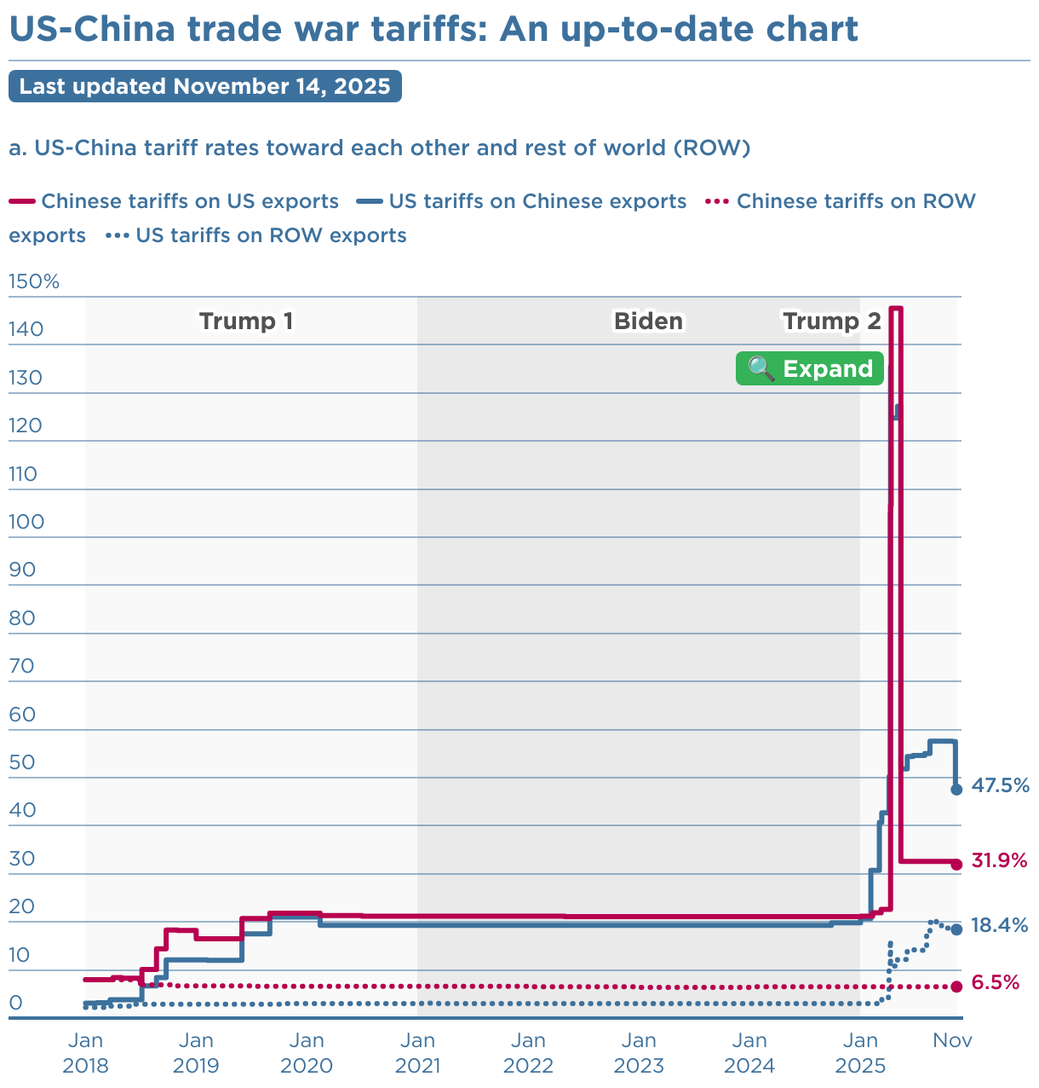

Slide 25
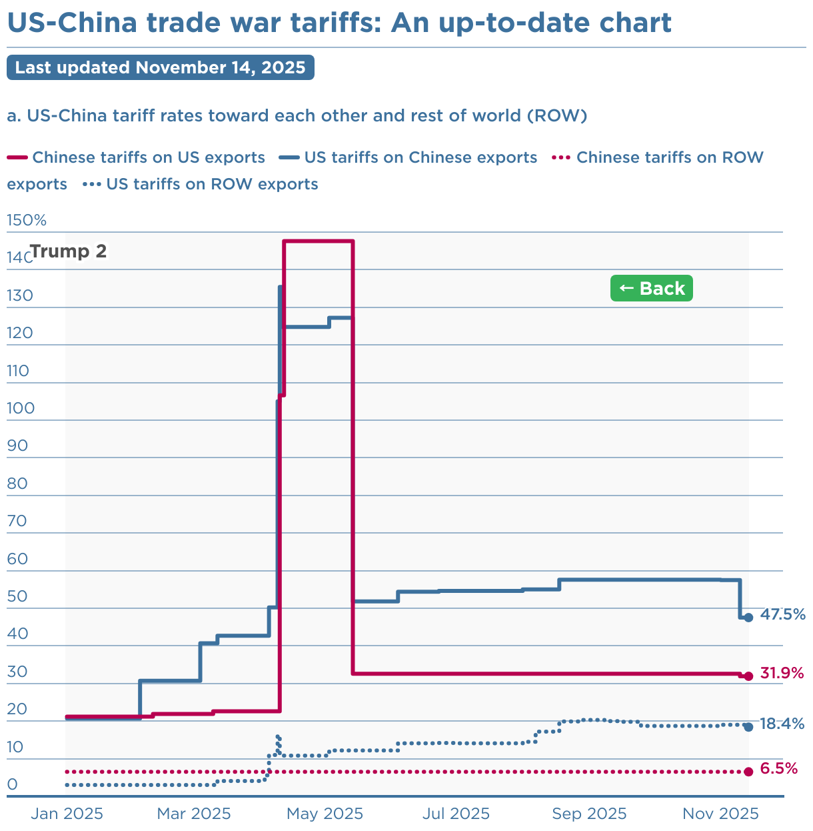

Slide 26
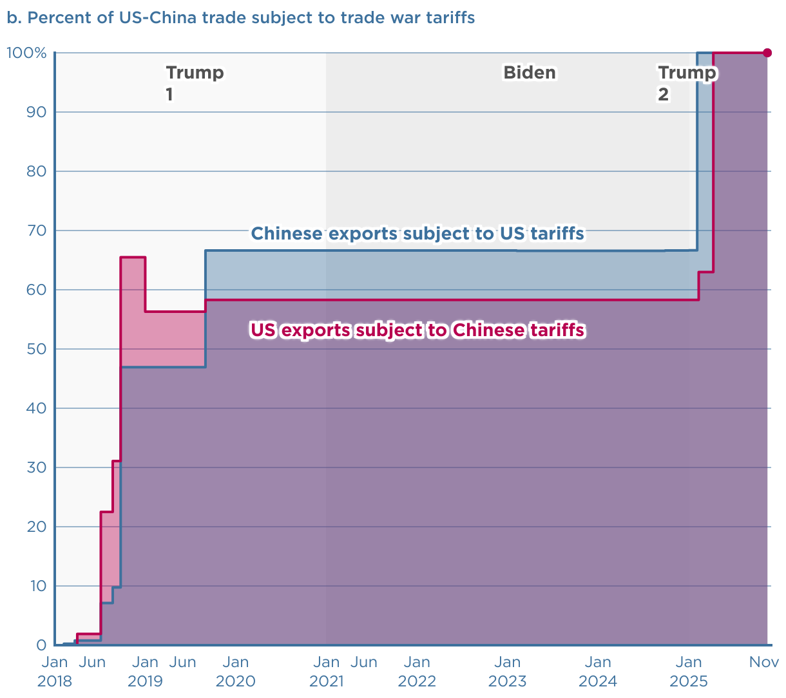
Share of Chinese Imports subject to Tariffs

Slide 27
A few more Things
Chinese retaliation includes export controls on some rare earth metals
Canada and Mexico tariffs apply to non-USMCA (United States-Mexico-Canada agreement) compliant goods only (e.g. autos)*
Some exceptions: coffee, beef, some fertilizers
Some compensation: soybean farmers
de minimis shipments from China subject to tariffs

Slide 28
Effects of Tariffs
Who pays for tariffs? Evidence from 2018 tariffs / Preliminary new evidence

Slide 29
Case study steel tariffs
Mar 1, 2018: Announces “national-security” tariffs on steel and aluminum
  25% on steel, 10% on aluminum
  Announced for all countries
    Some delayed (EU, Canada, Mexico)
    Others later exempted (S. Korea)

Slide 30
Steel and Aluminum
Who benefits?
  US producers of steel and aluminum
    Steel production increased 1.3% from 2018 to 2019
    Steel imports decreased 18% from 2018 to 2019
Who is hurt?
  US users of steel and aluminum pay higher prices
    Car companies, appliance makers, etc.
    BEA: 2 million jobs in US industries where steel >= 5% of inputs
Net effect:
  Peterson Institute (2019): negative $5.6 billion
  8,700 new jobs: Cost per job about $650,000 (steel workers’ average wage is $58k)
Notes:
https://www.thomasnet.com/nsearch.html?cov=MI&heading=1261809&loc=MI

Slide 31
An analysis of the washing machine tariffs reveals the creation of 1,800 jobs at a cost of $817,000 per job
(Source: Flaaen, Hortacsu and Tintelnot, American Economic Review 2020)

Slide 32
Who pays for tariffs?
Importer – firms or wholesalers “write the check” to the government
Tariff incidence:
- exporter if they lower the price they charge
- importer if the exporter does not change their price

Slide 33
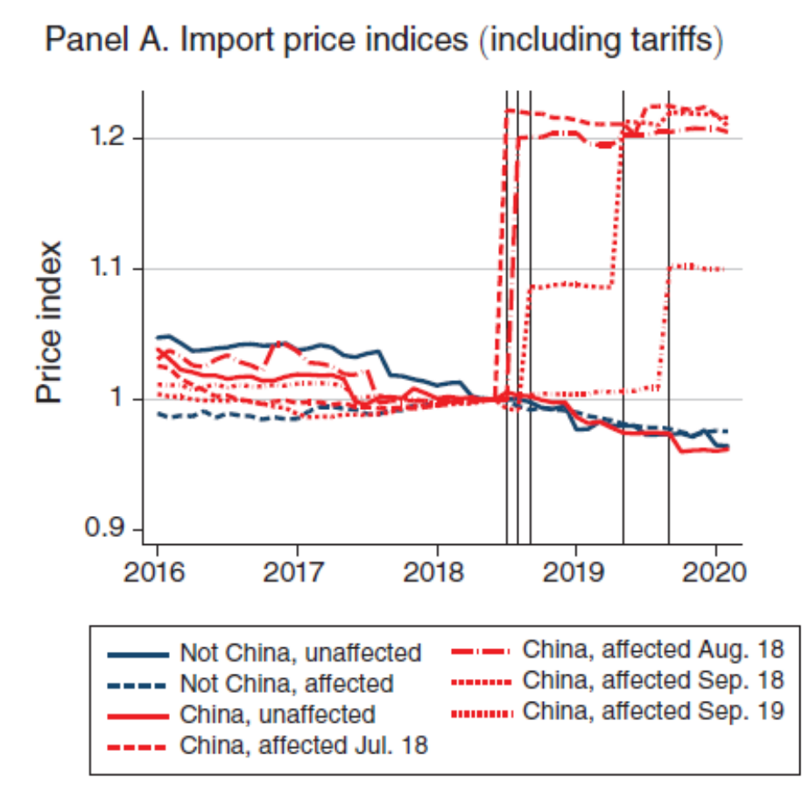
China import prices

Slide 34
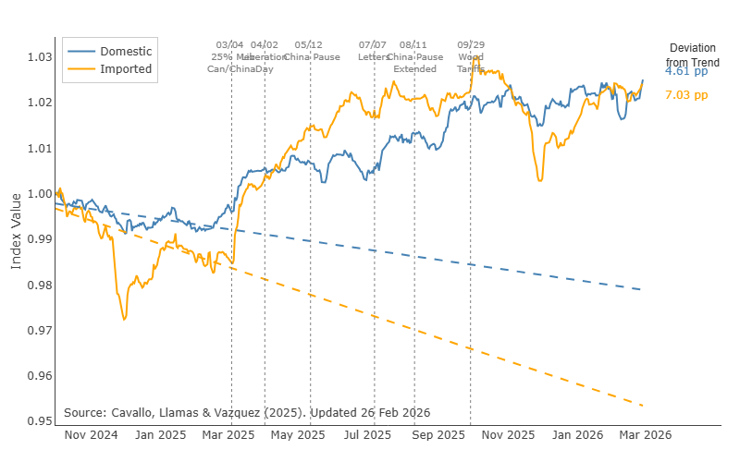
The price effects of the 2025 tariffs broadly

Slide 35
Effects of Tariffs
US consumers largely pay for the tariffs
Costly job creation
Tariffs are regressive

Slide 36
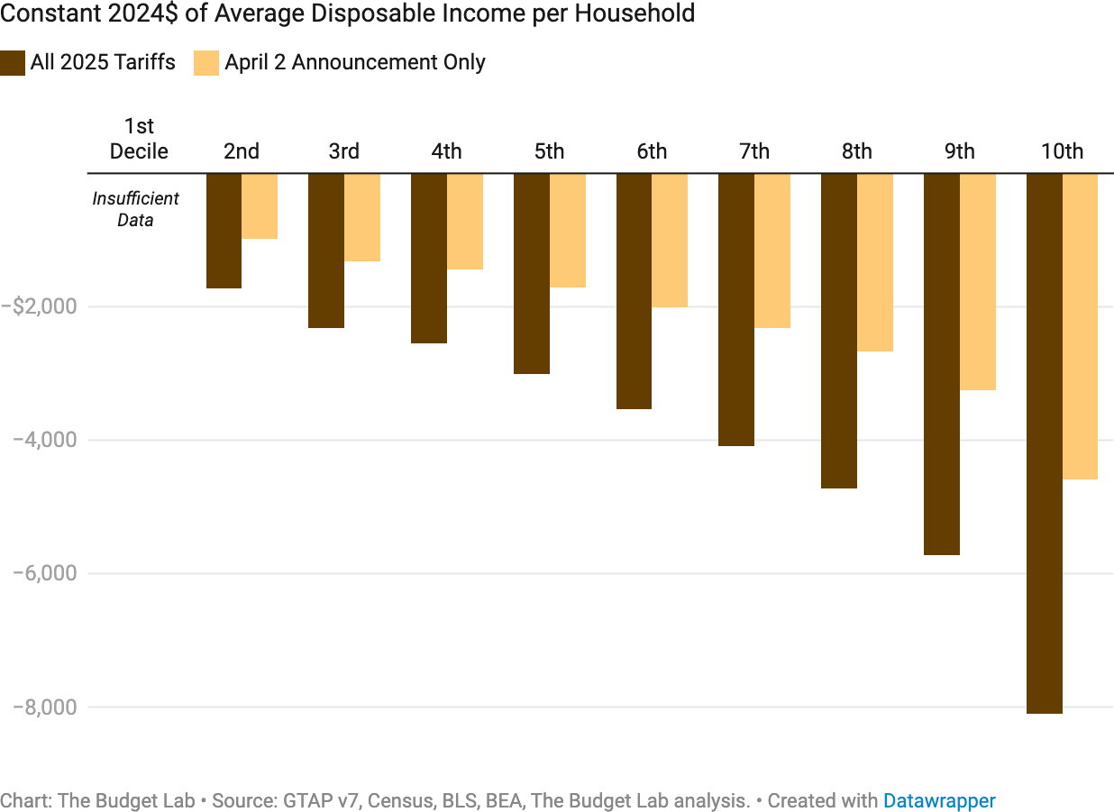
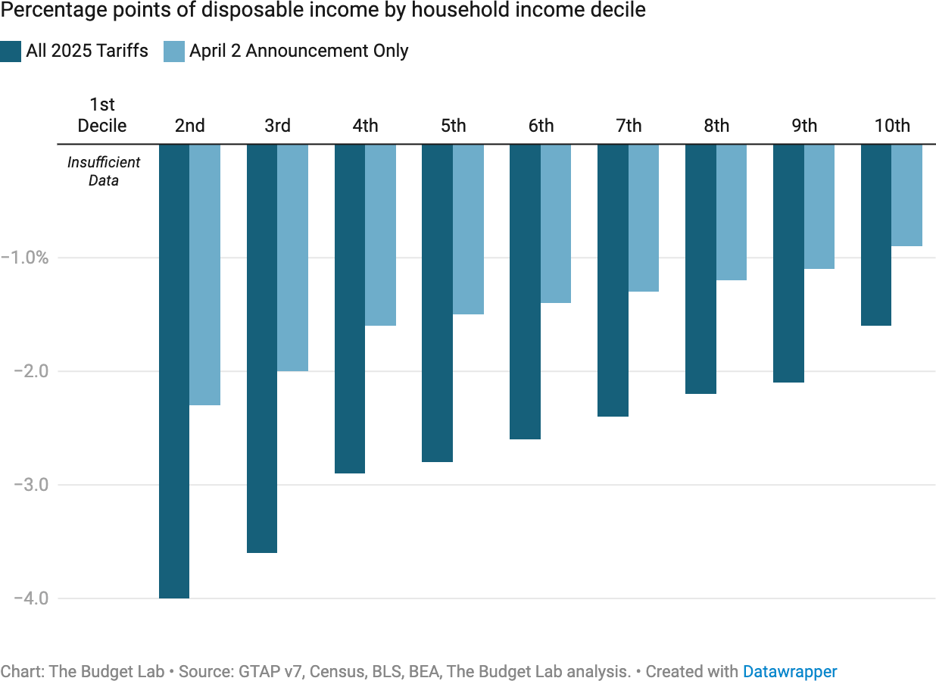
Effect of Tariffs on Households

Slide 37
What about lowering the trade deficit?
The 2025 goods deficit is at a record high despite the tariffs:
- Trade with China fell a lot, 29%, with Canada some, 6.4%
- Trade rose with a number of other countries: Mexico 4%, Taiwan 61%, Vietnam 40%, Switzerland 100%

Slide 38
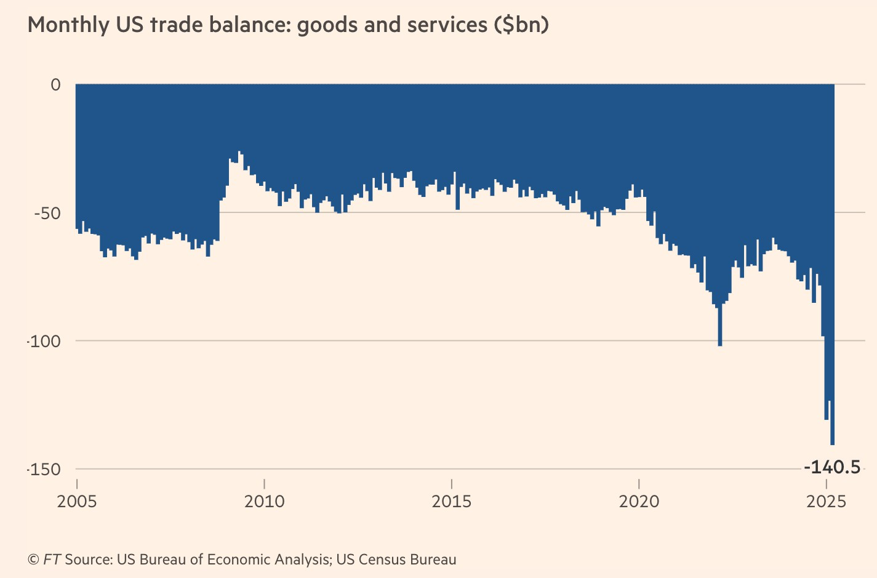

Slide 39
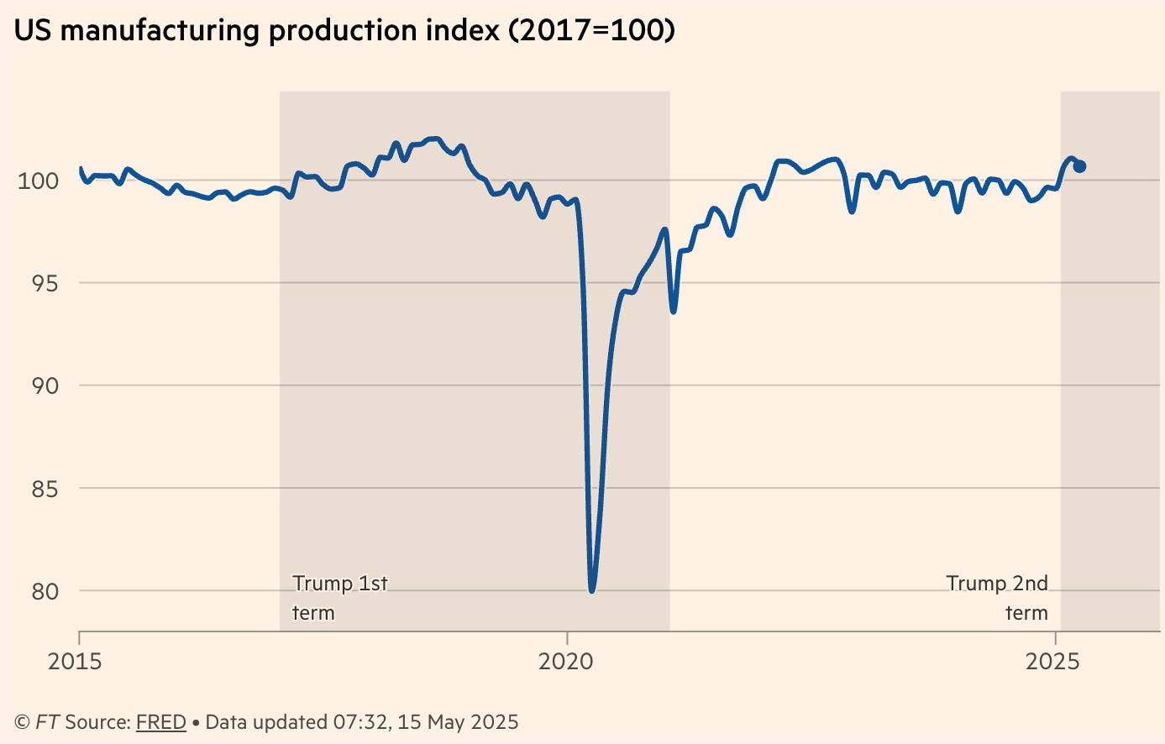
Has US Manufacturing benefited?

Slide 40
The Bigger Picture on World Trade
Concerns about unfair trade practices date back decades. The WTO is the forum to address these, but has been less and less effective
There have been no major new multilateral agreements since 1995
COVID-19 showed the fragility of global supply chains → some near-shoring → the trade war shows the fragility of the multilateral system
No end to broad tariffs and uncertainty in sight, though more opposition!?

Slide 41


Slide 42
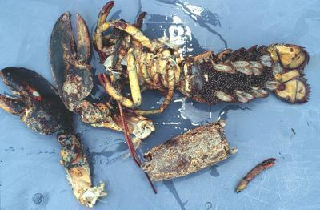

Slide 43
Thank you!
Questions?
andreas.waldkirch@colby.edu
www.NEEDEcon.org
Contact NEED: info@NEEDEcon.org
Submit a testimonial: www.NEEDEcon.org/testimonials.php
Become a Friend of NEED: www.NEEDEcon.org/friend.php

Slide 44

Next: The Atmospheric Greenhouse Effect
Sun
Atmosphere
Energy reflected back
onto earth
Energy reflected back
into space

